Slide 1


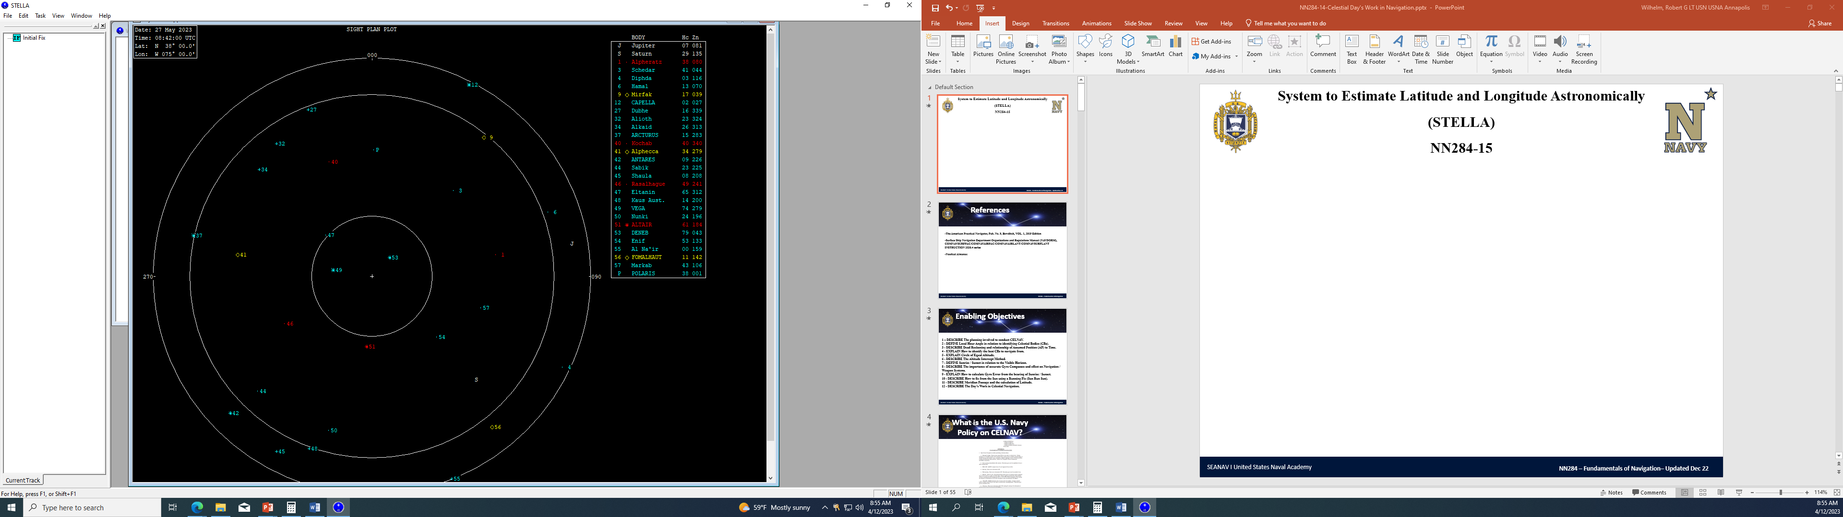
System to Estimate Latitude and Longitude Astronomically
(STELLA)
NN220-16
SEANAV I United States Naval Academy
NN220 – Fundamentals of Navigation– Updated May 2023
Operations Officer I HMS PROTECTOR A173 I The Ice Patrol Ship

Slide 2
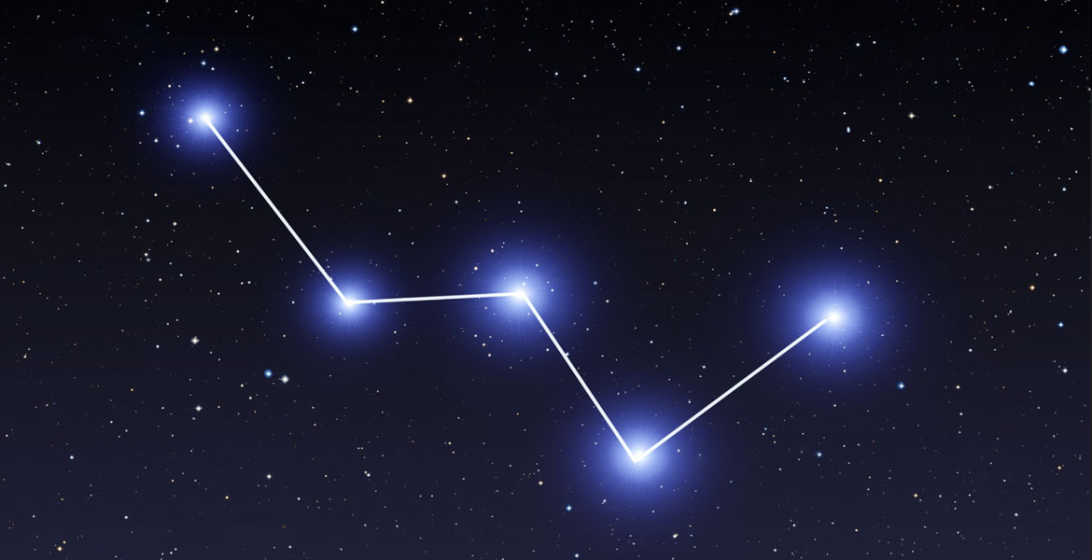
References
-The American Practical Navigator, Pub. No. 9, Bowditch, VOL. 1, 2019 Edition -Surface Ship Navigation Department Organizations and Regulations Manual (NAVDORM), COMNAVSURFPAC/COMNAVAIRPAC/COMNAVAIRLANT/COMNAVSURFLANT INSTRUCTION 3530.4 series -Nautical Almanac -System to Estimate Latitude and Longitude Astronomically (STELLA)
SEANAV I United States Naval Academy
NN220 – Fundamentals of Navigation
Operations Officer I HMS PROTECTOR A173 I The Ice Patrol Ship

Slide 3
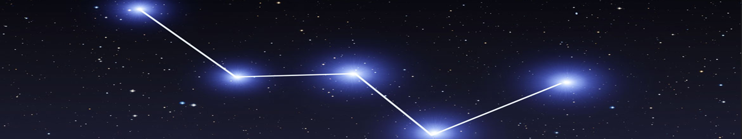
Enabling Objectives
1 – UNDERSTAND Practical application of STELLA. 2 - UNDERSTAND The Nautical Almanac function. 3 - UNDERSTAND How to input an Initial Fix. 4 - UNDERSTAND How to calculate Gyro Error using a Celestial Body. 5 - UNDERSTAND How to calculate the time of SR/SS/Twilight based on DR position. 6 - UNDERSTAND How to identify Celestial Bodies using the Sky Chart and Selected Stars functions. 7 - UNDERSTAND How to input Sights (Observations) and corrections. 8 - UNDERSTAND How to generate a Celestial Fix using the Altitude Intercept Method in STELLA. 9 - UNDERSTAND How to generate a Celestial Fix using Sun Run Sun.
SEANAV I United States Naval Academy
NN220 – Fundamentals of Navigation
Operations Officer I HMS PROTECTOR A173 I The Ice Patrol Ship

Slide 4
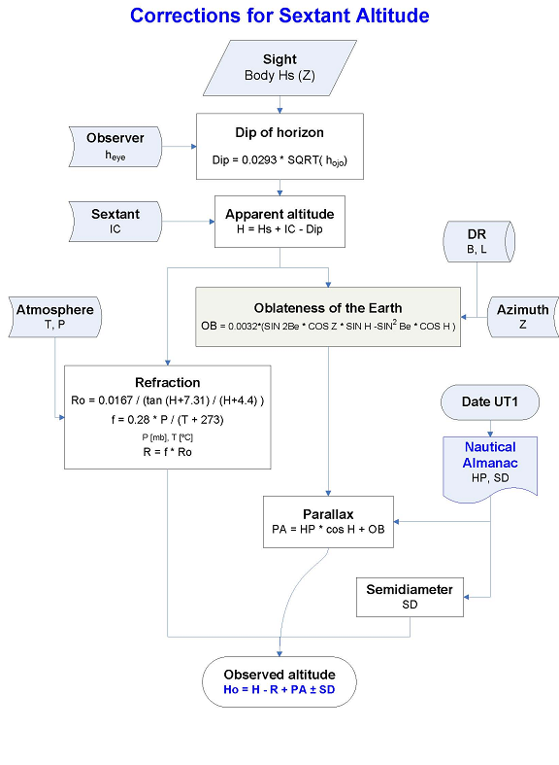
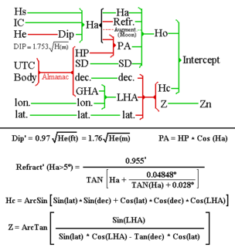
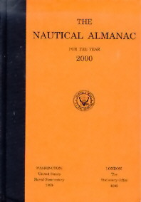
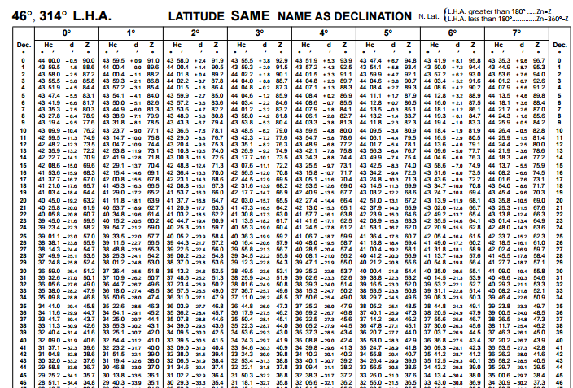
Nautical Almanac and Publications
Historically, CELNAV was completed manually, using Plotting Sheets and math.
In 1767, the work load was greatly reduced with the introduction of the Nautical Almanac and supporting publications. However, the process remained time consuming even when Teams were well practiced.

Slide 5
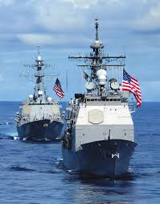
STELLA
System to Estimate Latitude and Longitude Astronomically – has been in Service for over 20 years.
US Naval Observatory Astronomical Applications Dept
Integrated into USN Block III NAVSSI
Provides ability to quickly:
Use Almanac Function to find Times / Declination / GHA of CBs
Celestial Body Rise/Set/Transit Calculations
Sight Planning
Sight Reduction
Reduces requirement to carry hard copy publications or to manually plot Celestial Fixes.

Slide 6
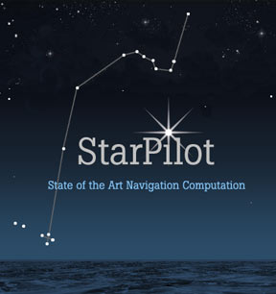
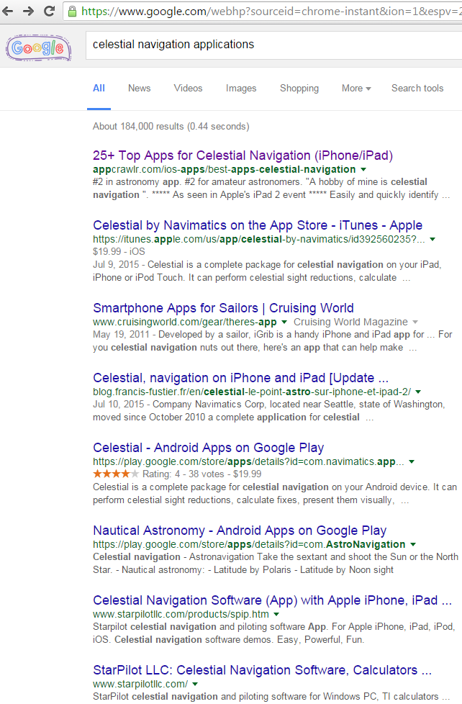
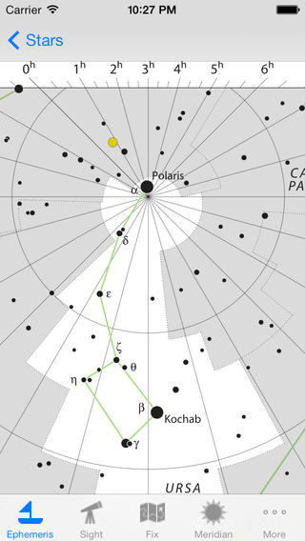
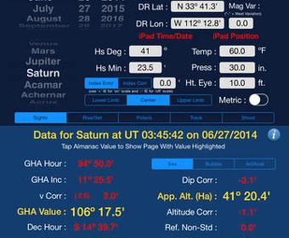
Embracing the Modern
Numerous similar systems available through vendors including Apple App Store and Google Play

Slide 7
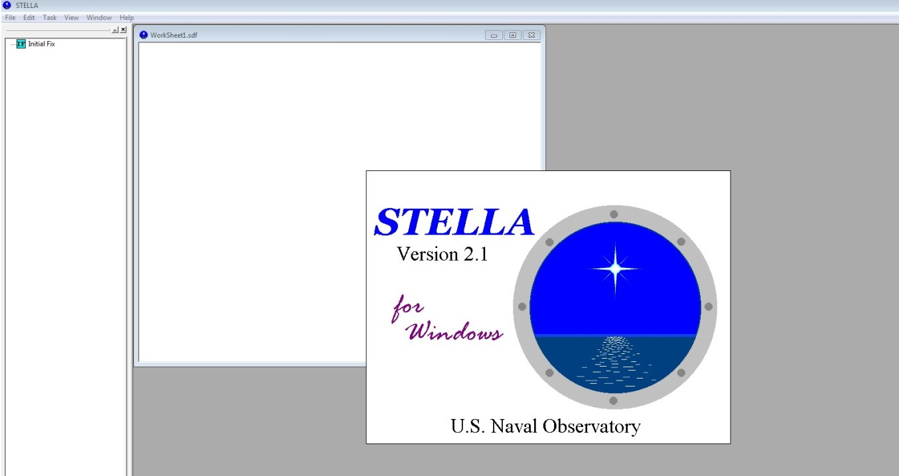
STELLA
VMS SCREENSHOT OF STELLA SHORTCUT

Slide 8
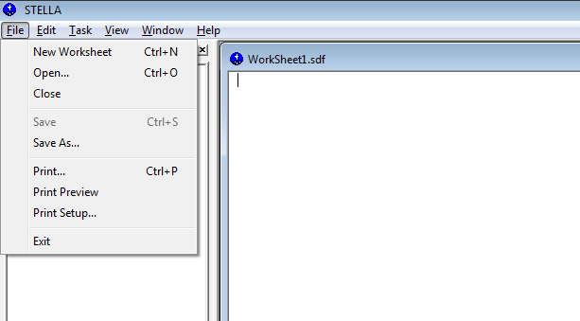
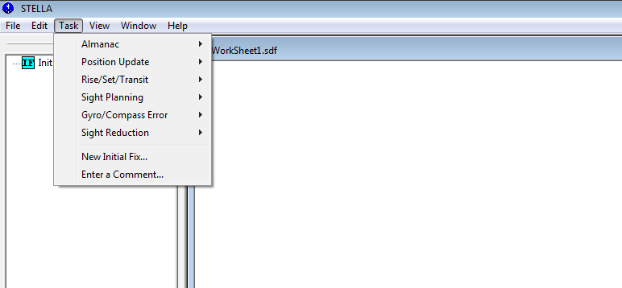
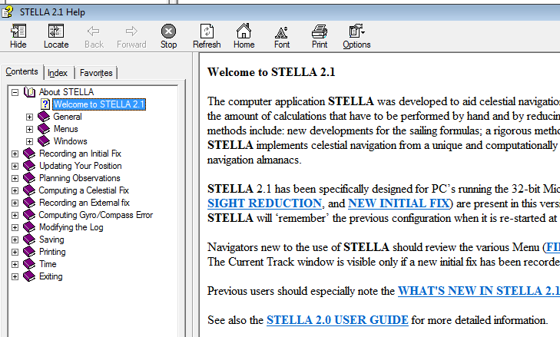
STELLA
Windows-based
Functional Tasks
Almanac
Position Update (DR)
Rise/Set/Transit
Gyro Error (SR/SS)
Sight Reduction
There is a help function!

Slide 9
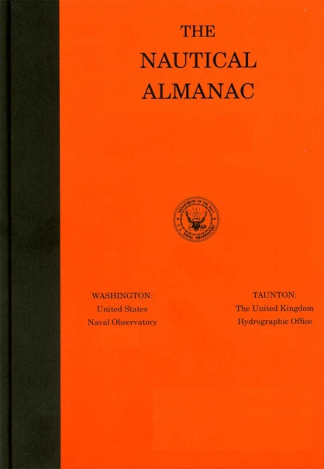
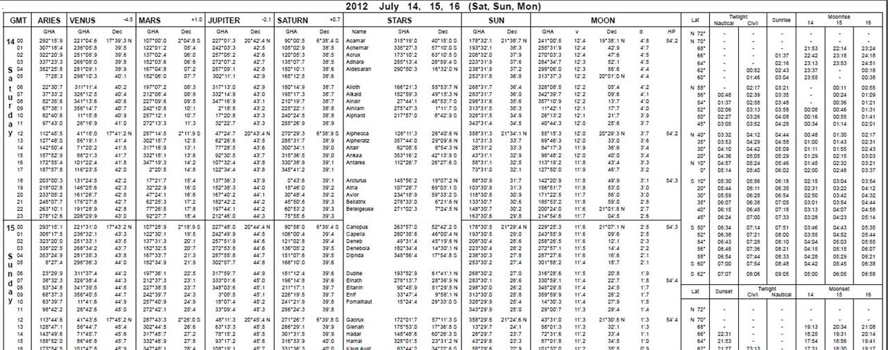
STELLA - Almanac
Nautical Almanac still produced annually
STELLA has all data in-built
Version 2.1 covers 1970-2024
Version 3.0 expected release in 2022/2023

Slide 10
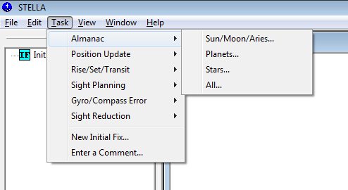
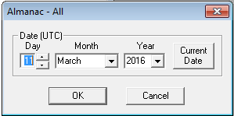
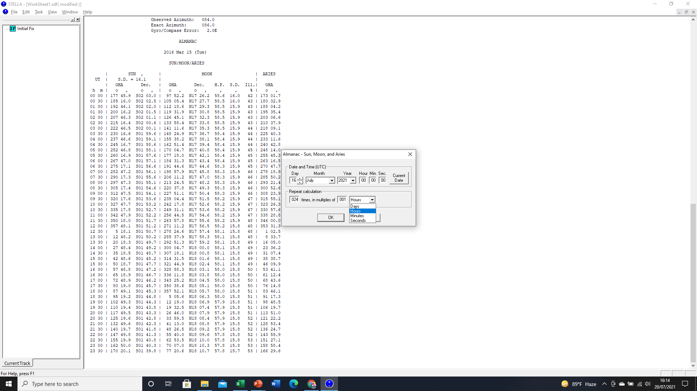
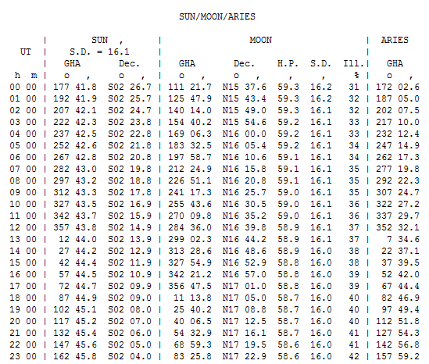
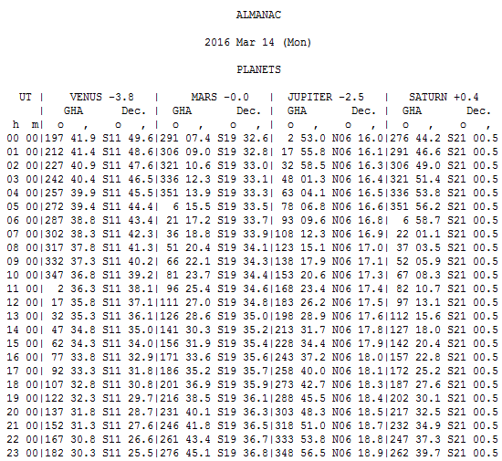
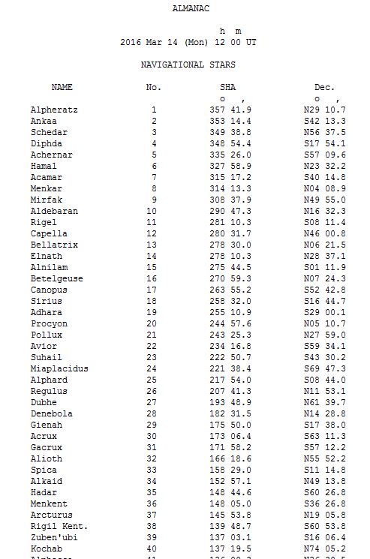
STELLA - Almanac
Using Almanac function you can select the objects for and date for which information is required.
You can select All bodies or be more specific
- Sun / Moon / Aries
- Planets
- Stars
When selecting specific details, you can set the interval of time based on Hours / Minutes over the period of a day.
This saves interpolation!

Slide 11
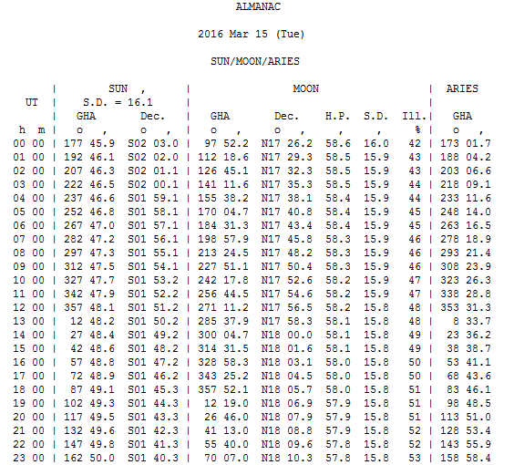
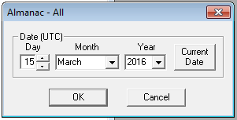
Practical Example - Almanac
At 0730R on 3/15/16
What were the Sun’s GHA and Dec?

Slide 12
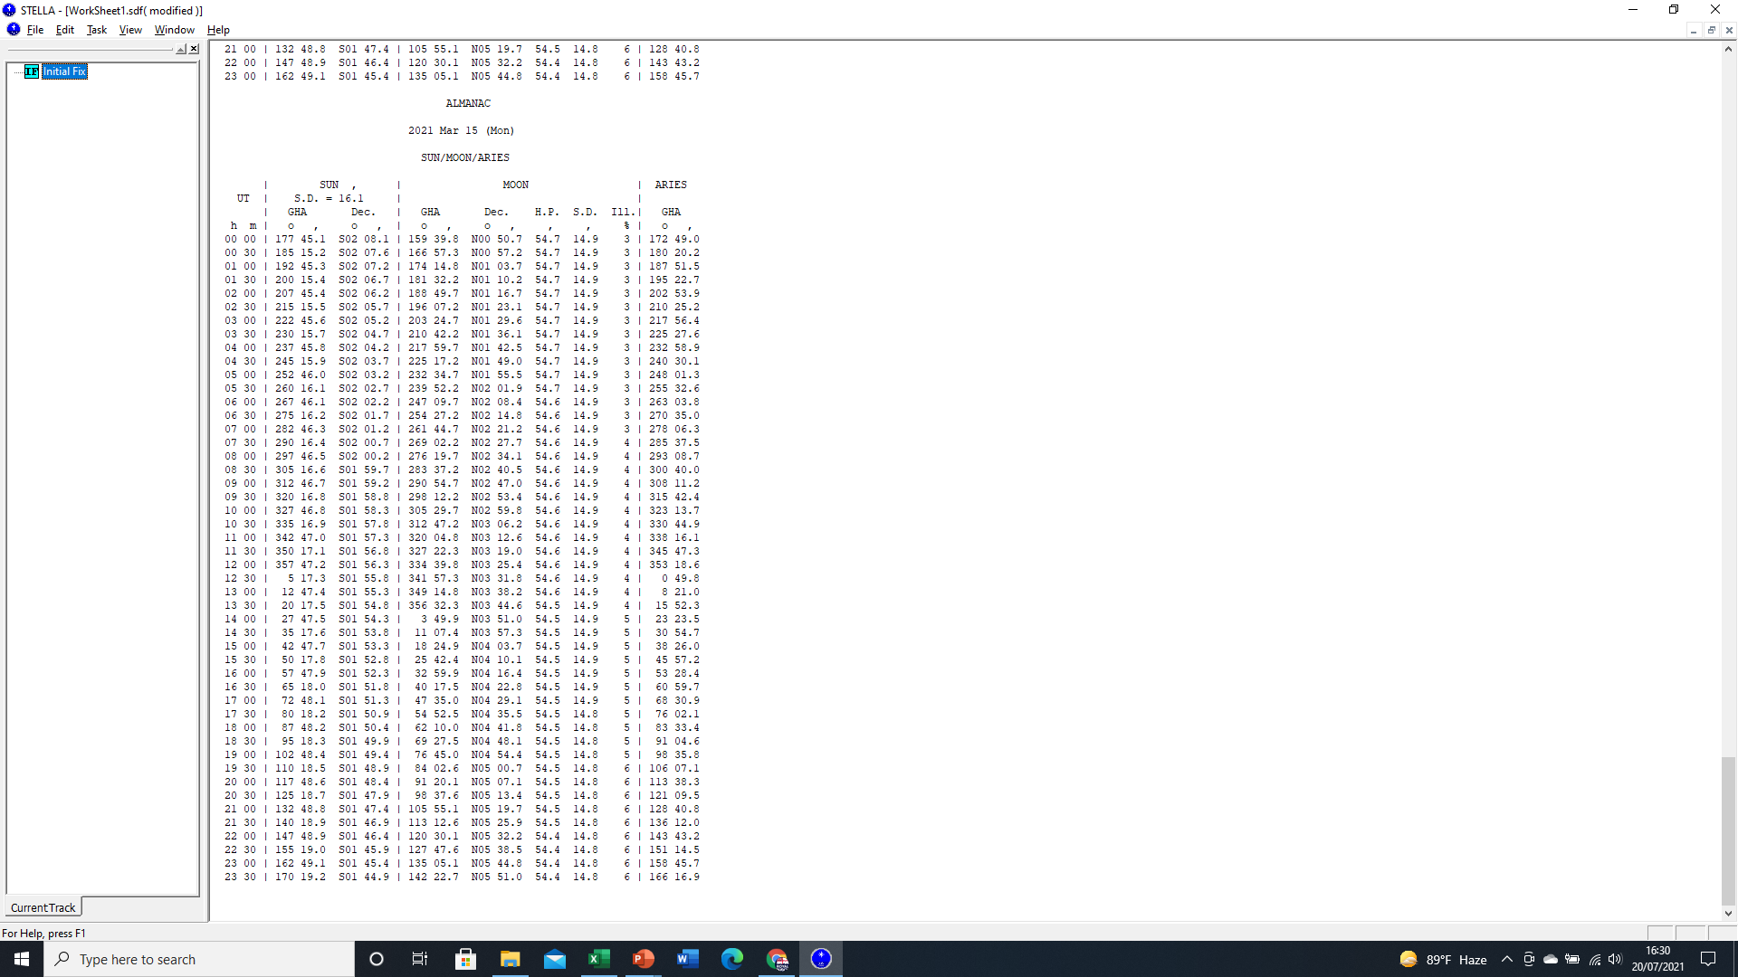
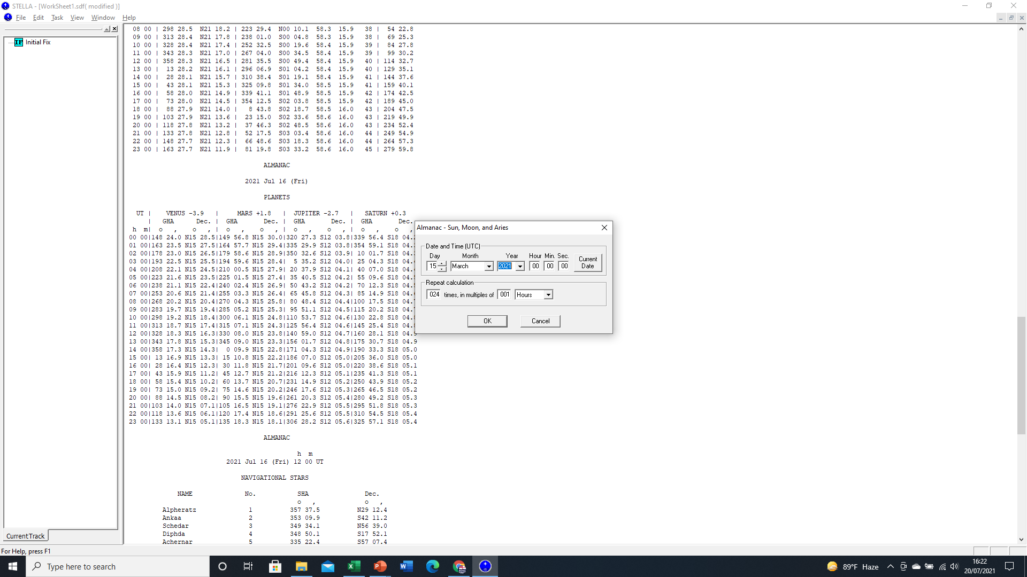
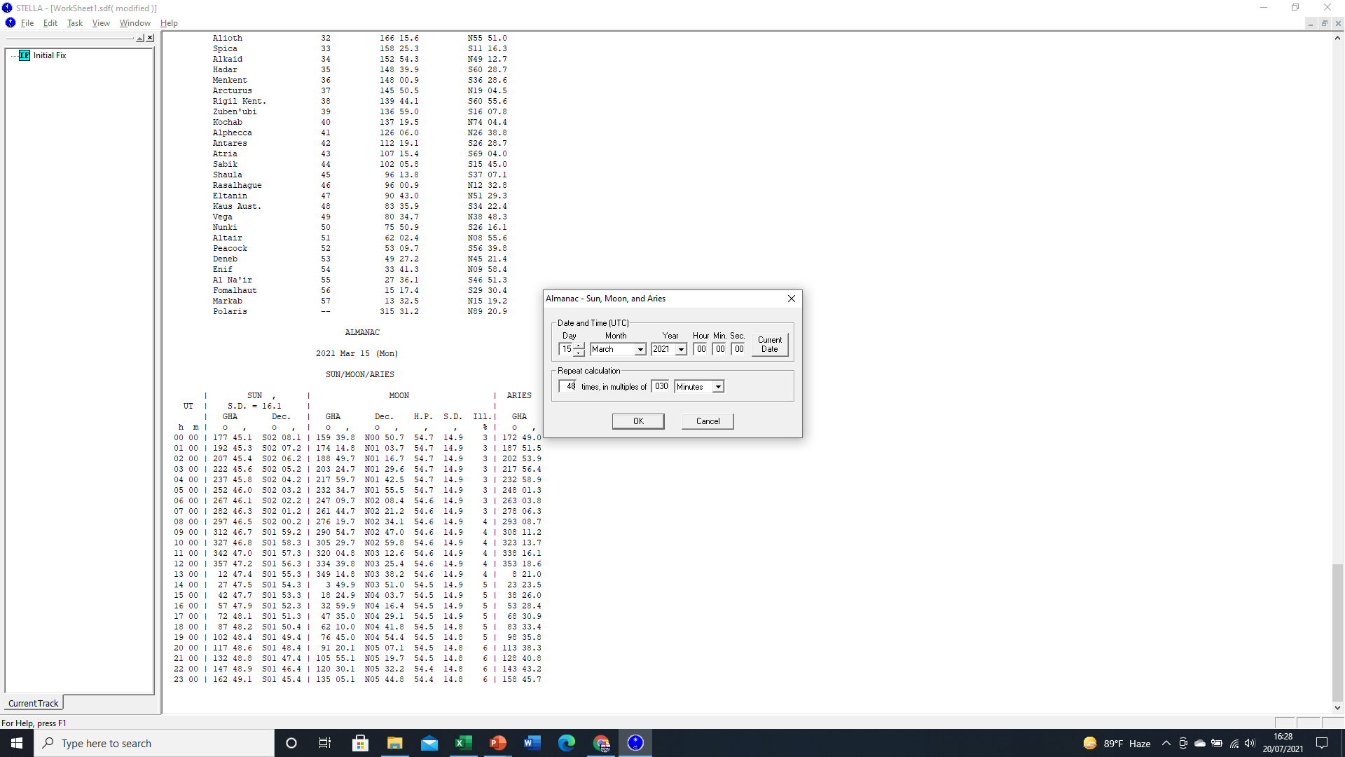
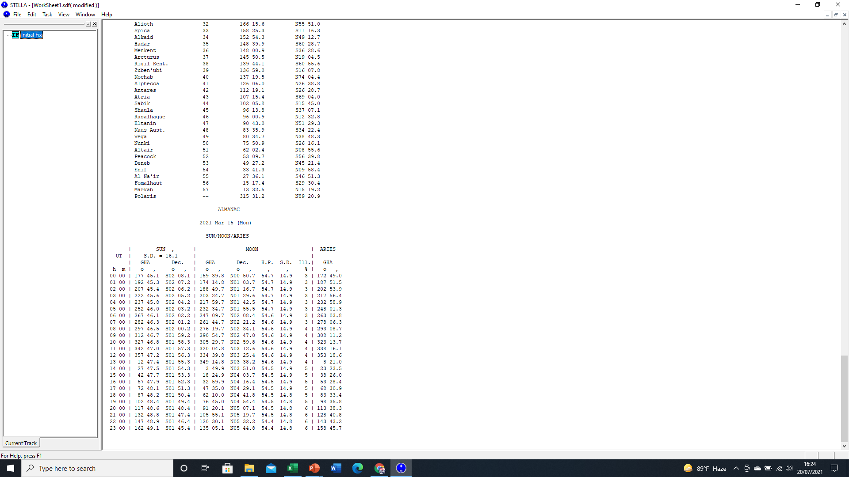
Practical Example - Almanac
At 0730R on 3/15/21
What were the Sun’s GHA and Dec?
Mathematical interpolation:
GHA
Declination
1200Z
357 47.2T
S01 56.3
1230Z
005 17.3T
S01 55.8
1300Z
012 47.4T
S01 55.3
Or get the system to do it for us.

Slide 13
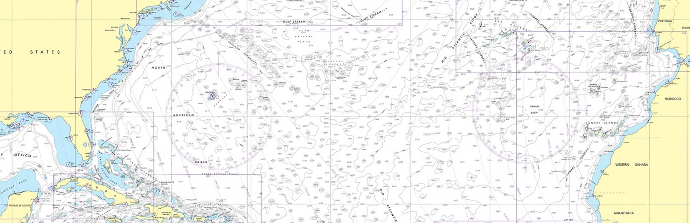
STELLA – Planning – Dead Reckoning
Remember, Celestial Navigation is all about planning in advance and Time.
Whilst STELLA is integrated into VMS, positioning information is not transferred between software systems. Therefore, our Assumed Position must be generated by working out Dead Reckoning based on the last good fix.
1145R
Our last fix using LOP is at 0945R
Cse is 085° Sp 20kts

Slide 14
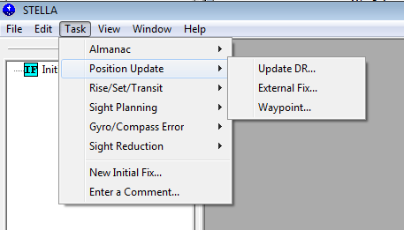
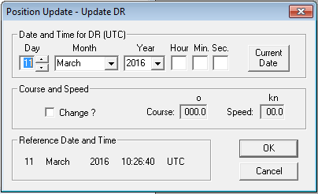
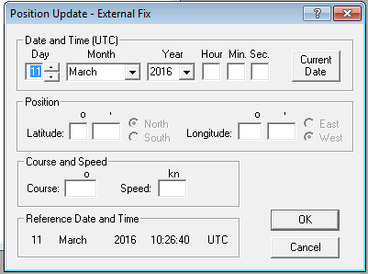
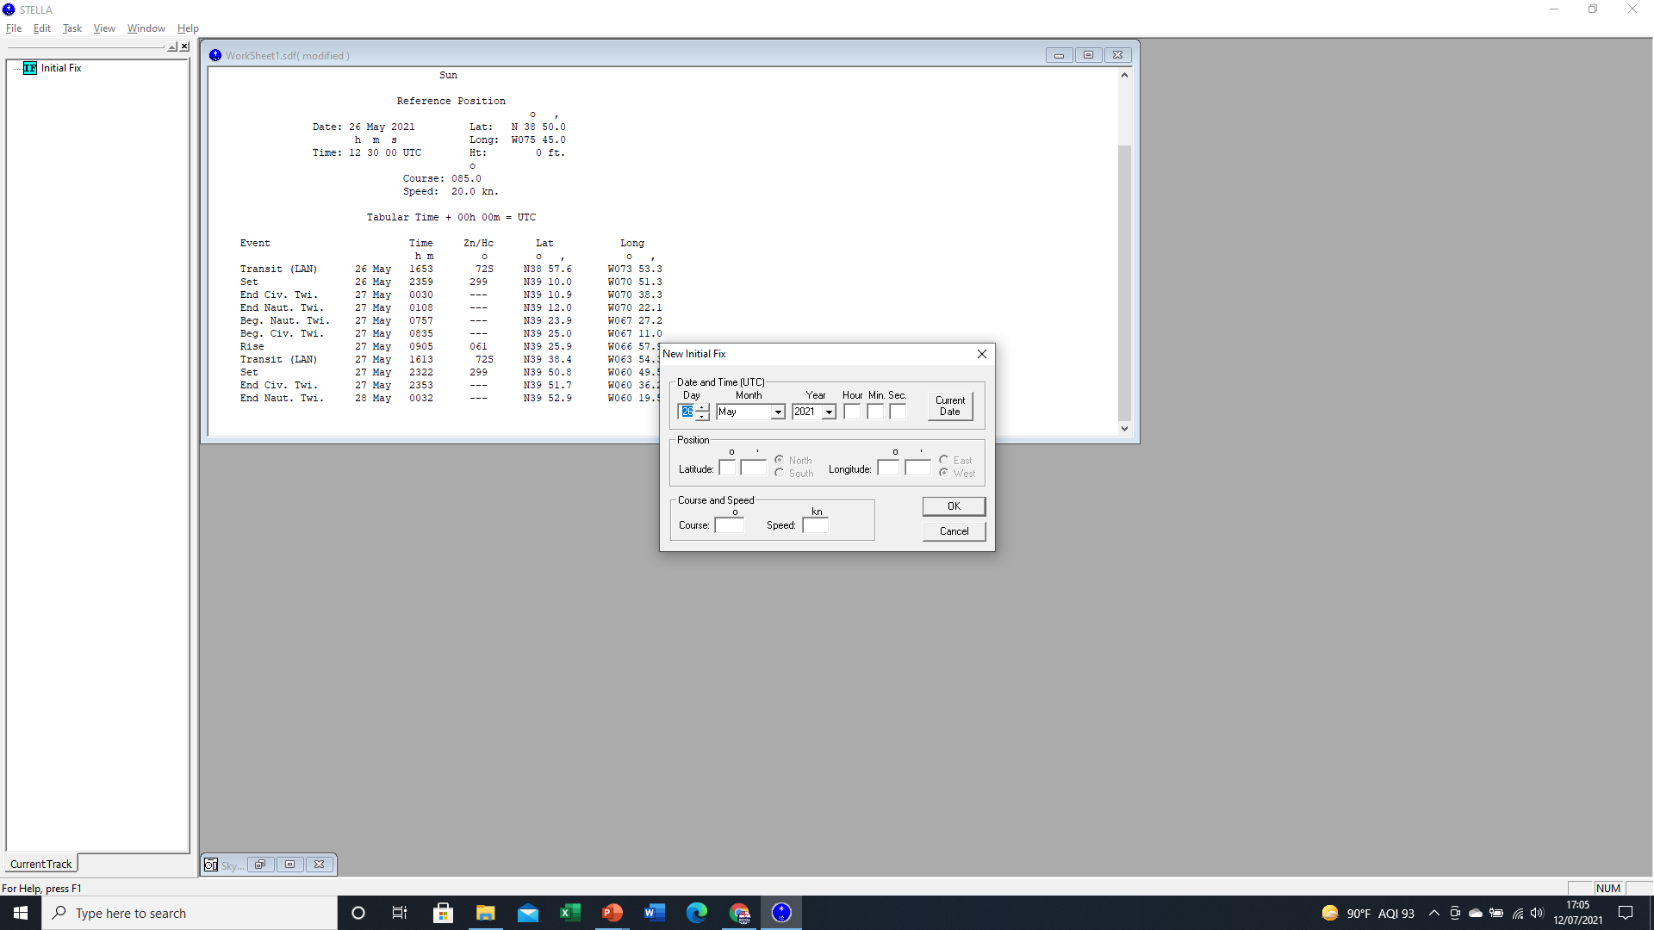
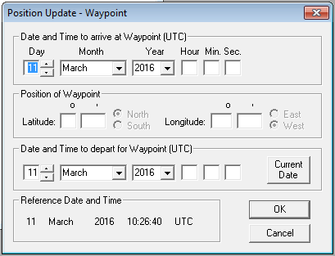
STELLA – Planning - Time
Ship’s position must be updated by first inputting a New Initial Fix, including Course and Speed.
The system creates a ‘Work Sheet’ that records all inputs and information.
The system will predict future positions based on the Course and Speed inputted. Adjustments can be inputted along the way. All predictions based on this information.
Keep all Times to Zulu to avoid confusion.

Slide 15
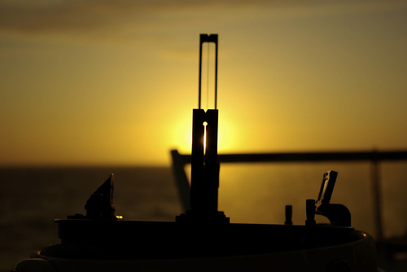
STELLA – Gyro Check
Our Gyro Compass feeds into equipment such as Weapon and Sensor systems. For navigation, when we take bearings to Fix position or to monitor Head or Turn bearings, we need the Gyro to be accurate.
Depending on the type of Gyro, accuracy will vary.
On mechanical gyroscopic compasses, accuracy is usually acceptable to within +/- 2°.
On more modern gyros, such as Ring Laser Gyros, accuracy is far better to less than 0.5°
We can predict the Azimuth (True Bearing) of a Celestial Body based on a predicted Time and Position using STELLA and compare our Gyro’s bearing to the calculated Azimuth of the object to establish error.

Slide 16
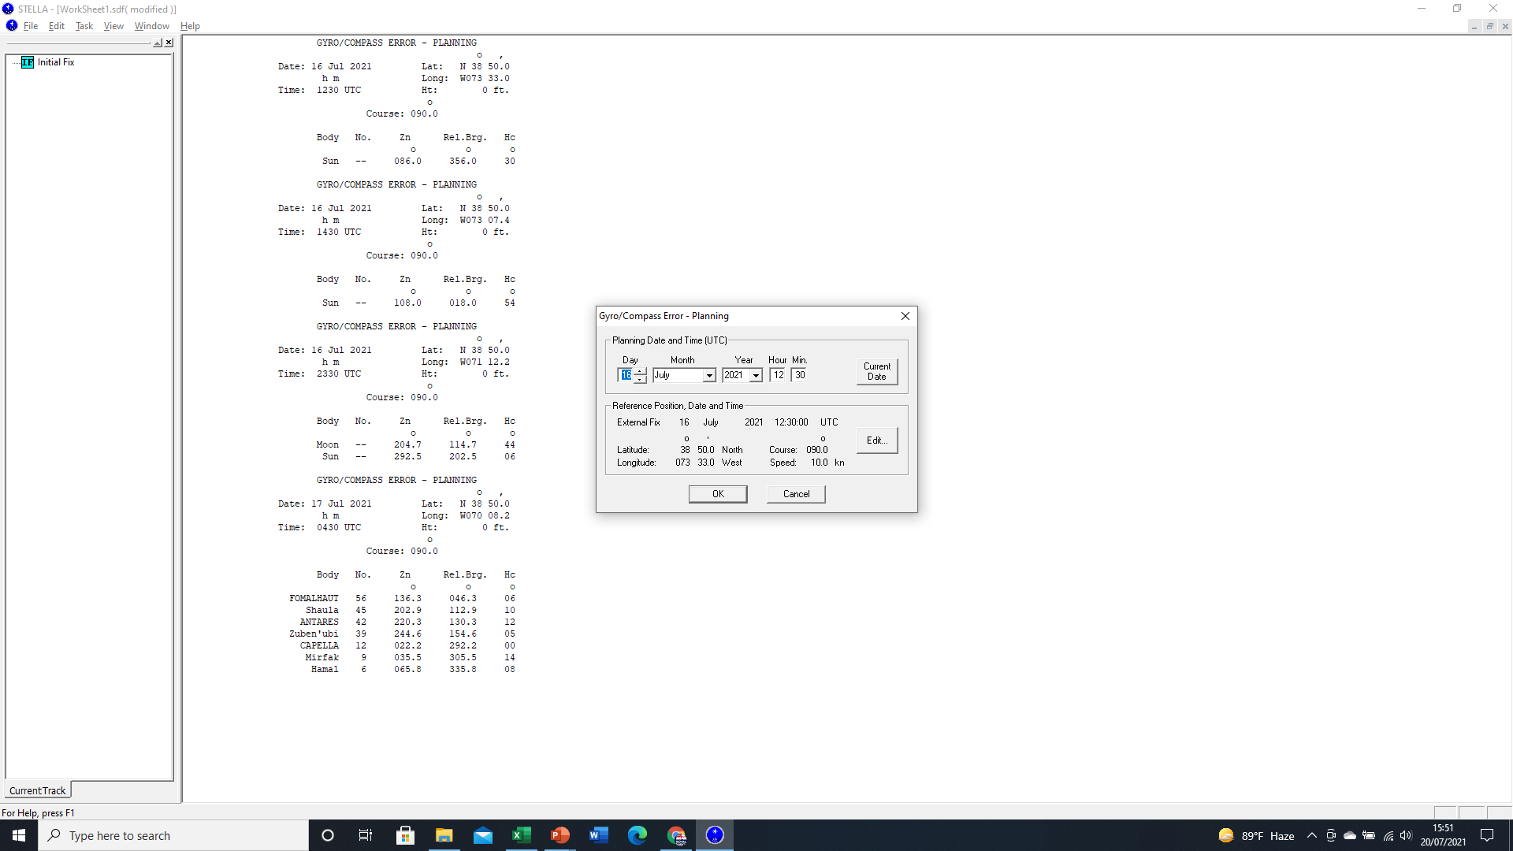
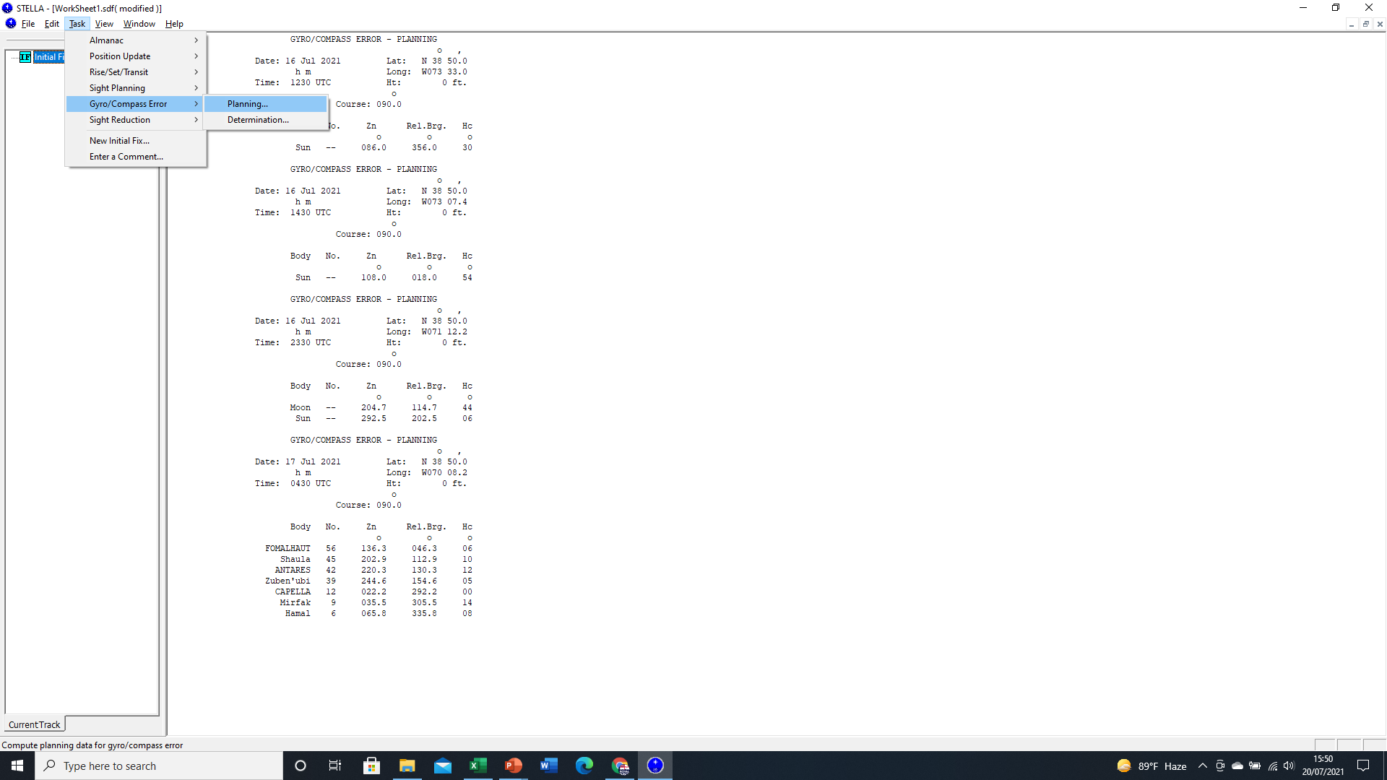
STELLA – Gyro Check
Using the Gyro/Compass Error Planning function STELLA will provide the Azimuth of objects, based on the Initial Fix, subsequent DR and Time selected.
Based on the time of day selected, STELLA will predict the objects that should be visible.
This includes at night.
However, taking bearings of Celestial Bodies such as Stars can be inaccurate, especially when at a high Altitude.
Generally, Gyro’s are checked at Sunrise and Sunset, when the Sun is a semi diameter (34’ minutes of arc) above the Visible Horizon.

Slide 17
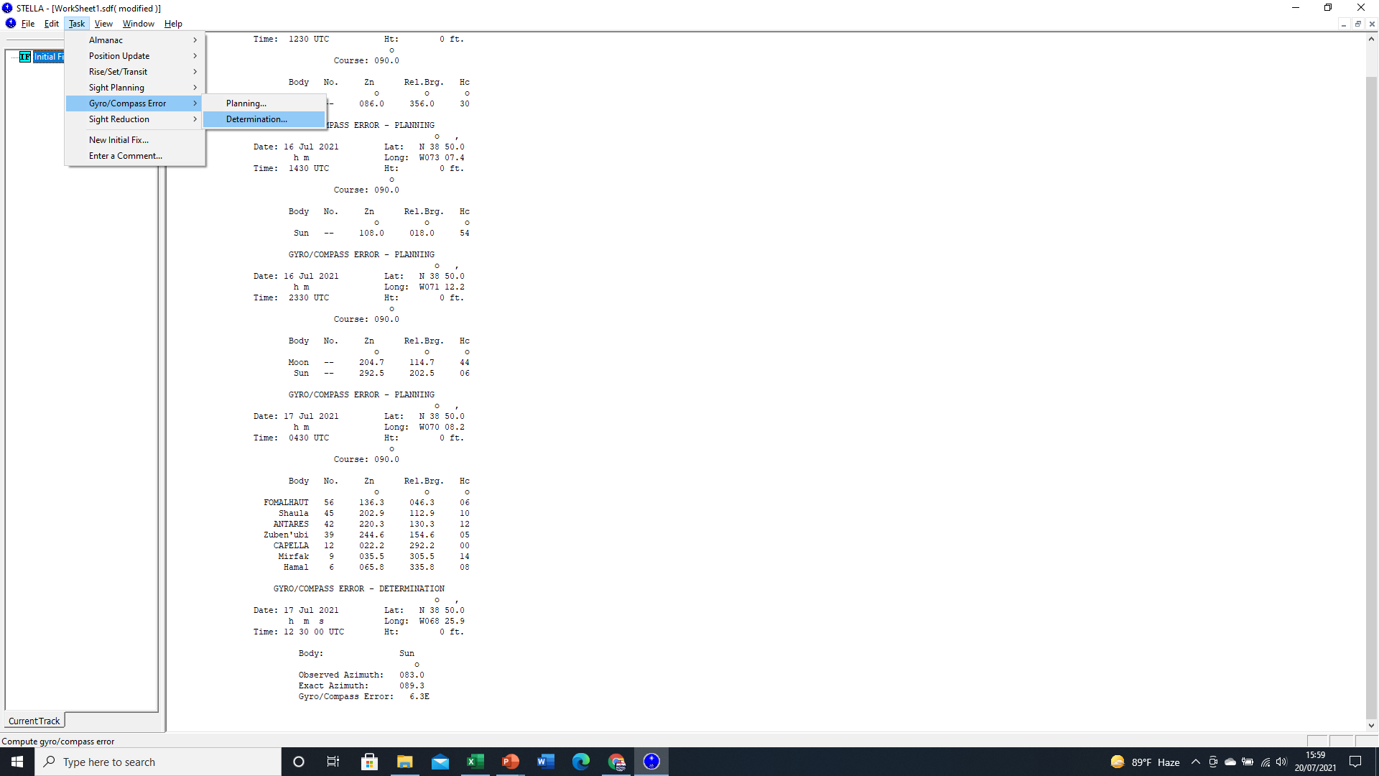
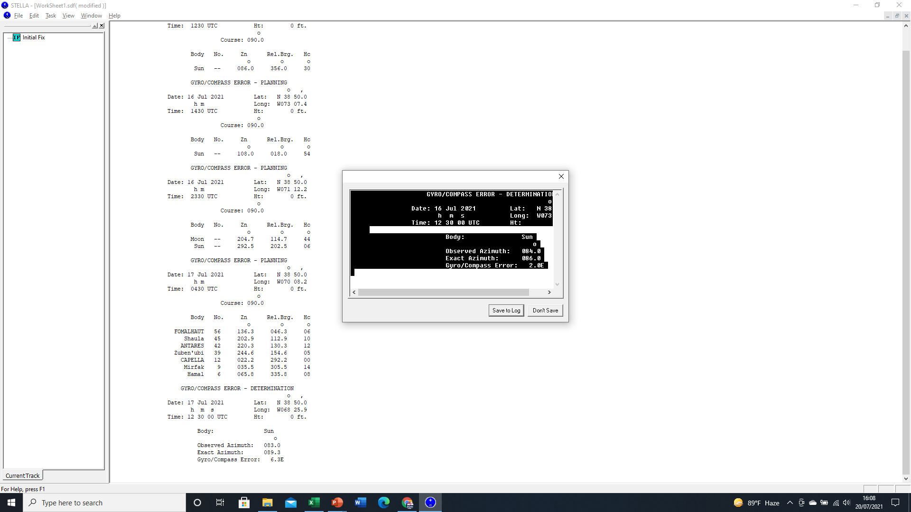
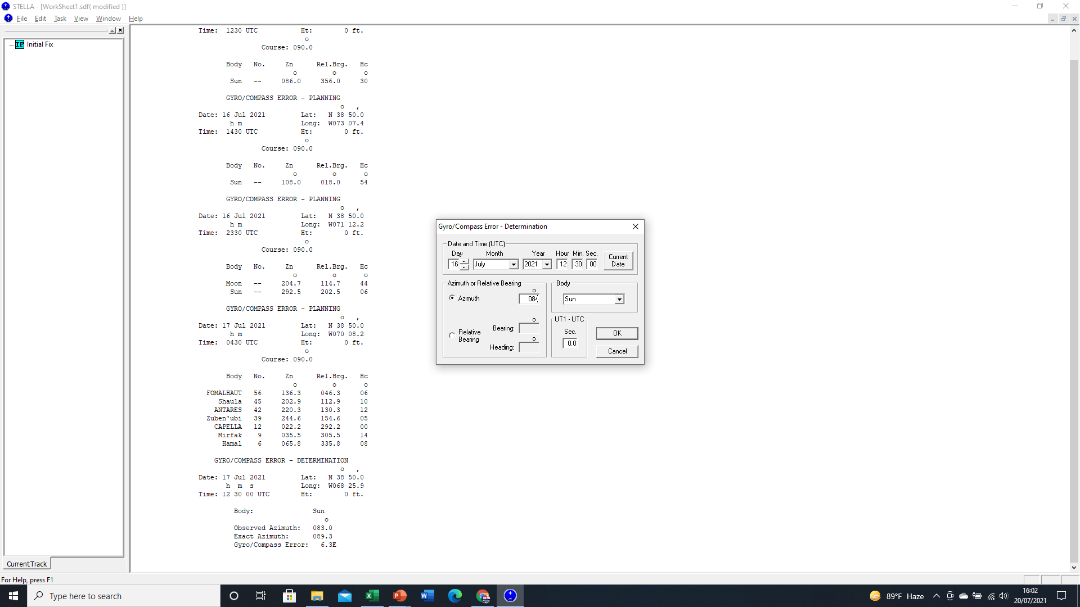
STELLA – Gyro Check
Using the Gyro/Compass Error Determination function STELLA will compare the Azimuth of an observed object, doing the calculation of error for us, at any time of the day.
The Azimuth calculated by STELLA is only as accurate as the last Fix and the subsequent DR.
It will only allow you to select Celestial Bodies that are visible at the time.
The calculation can be recorded to the Worksheet for future comparison.

Slide 18
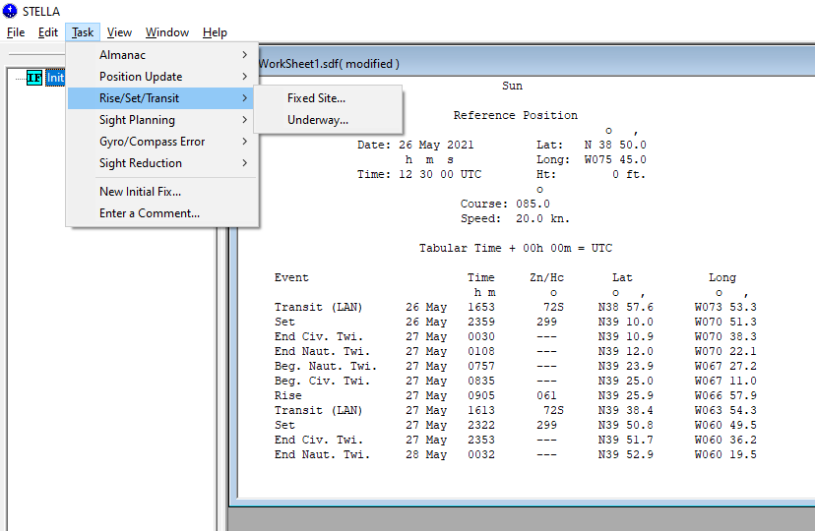
STELLA – Planning Sights - Time
Before taking Sights, we need to know the Time of SS / SR and the associated period of Twilight.
Times can be calculated based on a Fixed Position or a future DR predication, based on our inputted Course and Speed.
Information is recorded on our Work Sheet.
Times are associated with DR positions.

Slide 19
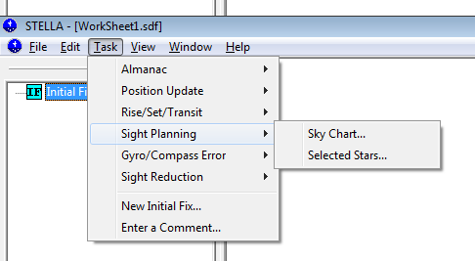
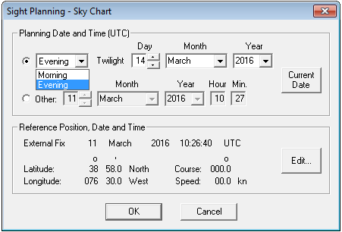
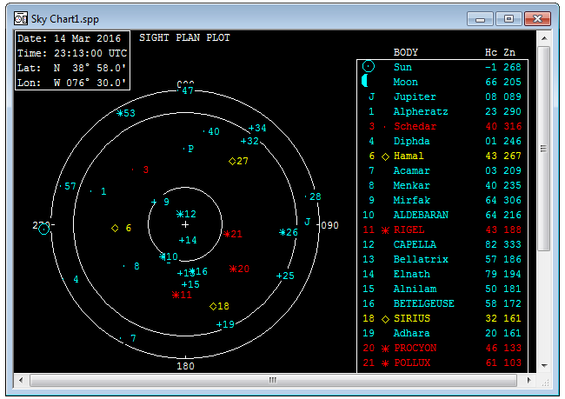
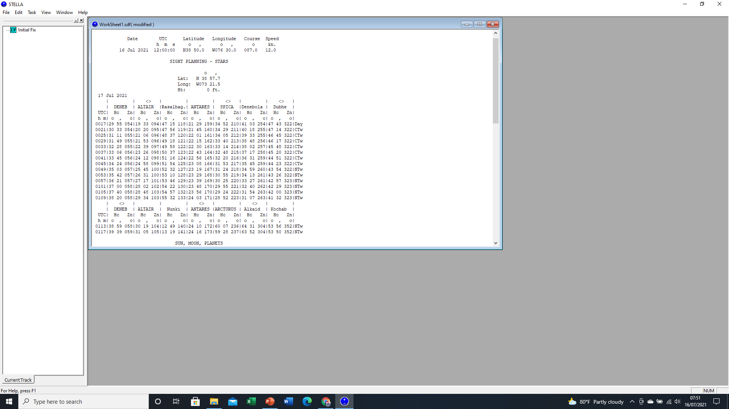
STELLA – Planning Sights
When planning to take fixes of Celestial Bodies including Stars and Planets, the system will ask whether Morning or Evening Stars.
Remember times are in Zulu! You must select the correct date and Morning or Evening to get the correct prediction.
It displays a Star Chart for a specific Time based on times of Twilight and the DR Course and Speed inputted. This provides a visual representation of where CBs are in relation to us.
It will also provide us a list of the best 7 selected Stars and planets. This list covers Altitude and Azimuth change through the period of Twilight.

Slide 20
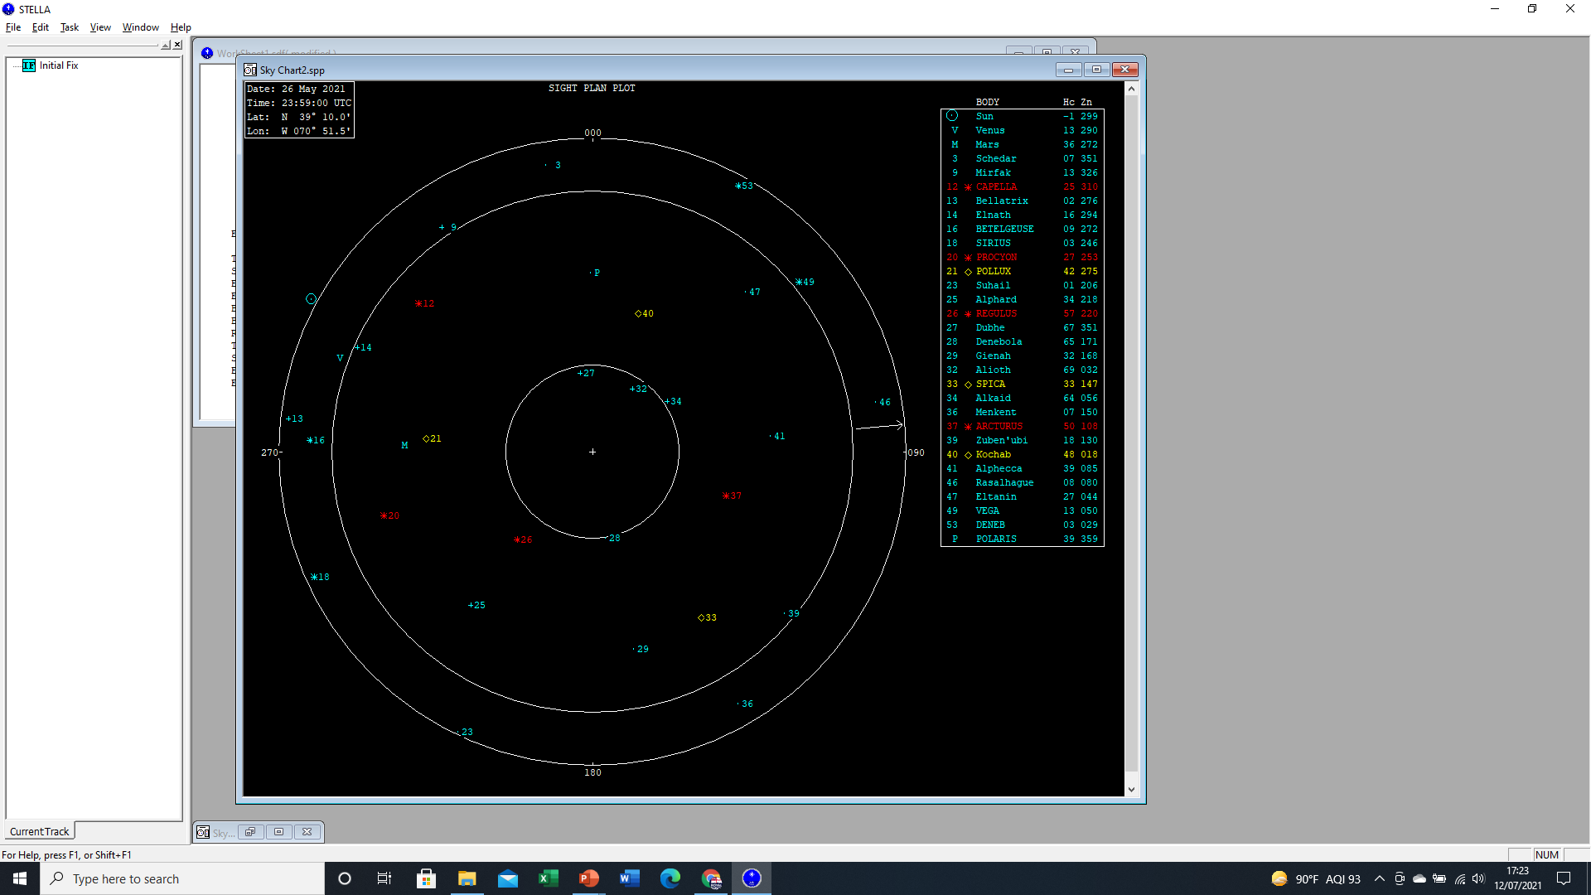
Date
Time(Z)
Celestial Bodies listed to the top right:
Lat/Long
Stars, Planets, Moon & Sun
Listed by
Hc
Zn
Brightness
Our AP is at the Center of the Chart marked with a +.
It also represents our Zenith Position i.e 90° Altitude
Yellow highlights the best 3 Stars for a Fix.
Red indicates the other 4 of 7 best Objects
Blue Bodies are usable but not recommended

Slide 21
On the main Chart, CBs are shown on their respective Azimuth (True Bearing)
For example, POLLUX’s Azimuth is 275° from us.
POLLUX’s Height Calculated or Altitude is predicted as 42°. This is measured between the Visible Horizon and our AP / Zenith at the center.
Where the Zenith is at the center of the Chart, the Visible Horizon is represented by the outer Circles.

Slide 22
STELLA – Planning Sights
The Selected Stars function is based on Publication 259. It lists the 7 best stars and planets for a Celestial Fix based on Time and Assumed Position (AP).
The Time Window covers the period of Twilight. Times are set to ever 4 minutes (1° of Longitude).
The list details the 7 Best Stars and highlights the 3 best based on Magnitude, Separation and Altitude.
Using this function, you can gain a fell for how the Altitude and Azimuth of a CB change through the period of Twilight.

Slide 23
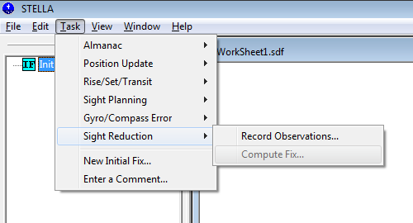
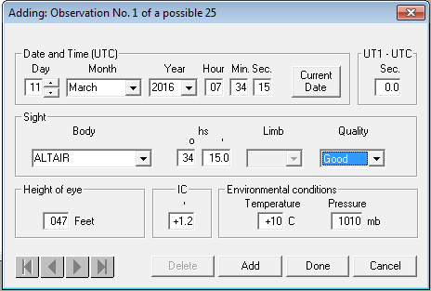
STELLA – Sights Reduction
Once sights have been physically taken using our Sextant, we can Enter Observations and Corrections.
Date/Time – must be accurate because
of the rate of movement of the Body.
Body & Observed Height (hs)
HoE of the Bridge Wing (Dip)
IC (Index Error). Measured On or Off the Arc. On the Arc – Subtract. Off the Arc – Add.
Environmentals to account for refraction.
We can input up to 26 observations. We should only need a minimum of 3 LOPs to get a fix. But we normally take 6-7 just in case!

Slide 24

STELLA – Sights Reduction
UT1-UTC
Difference from UTC displayed on GPS unit
Posted by USNO online
Less than one second
If unavailable, use zero

Slide 25



STELLA – Sight Reduction
Fixes are calculated using the Altitude Intercept Method.
Desired time of Fix calculation is selected based on Observations. Usually, Time of Last Observation selected.
Press Enter to get Solution
Displays AP and plotted Lines of Position (LOPs)

Slide 26

The Fix position appears here. It will provide an error of Latitude and Longitude to indicate the accuracy of the Fix.
Individual LOPs can be highlighted from the list at the Top Right.
This allows easy identification of any LOP that might not have been accurate when sighted.

Slide 27


STELLA – Sights Reduction
If an error is made when inputting a Sight, you can re-enter and adjust the Observation’s details.
Once amended, you can re-calculate the Fix position.

Slide 28
Practical Example – Planning Sights
The time is 0730R on 15 Mar 16.
You are in Annapolis (initial fix 38°58’N 076°30’W) and planning a transit to Cape Charles.
Planned course and speed is 150°T at 10kts
What will be the 3 best stars to use for a fix this evening?
At what time?
What will be their expected Azimuth and Altitude?

Slide 29



Practical Example – Planning Sights
Set Initial Fix

Slide 30


Practical Example – Planning Sights
Or update position…

Slide 31


Practical Example – Planning Sights
What will be the 3 best stars to use for a fix this evening and at what time?
HAMAL
SIRIUS
DUBHE
What will be their expected Azimuth and Altitude?
HAMAL Hc 42°, Zn 269°T
SIRIUS Hc 34°, Zn 162°T
DUBHE Hc 37°, Zn 036°T

Slide 32
Practical Example – Planning Sights
Using these three stars, you observe the following star sights:
Altitude (Hs) Time(R) Quality
SIRIUS 34°07’ 1808:11R Good
HAMAL 43°32’ 1807:31R Avg
DUBHE 36°24’ 1812:44R Good
Index Error 1°00’ Minute Off the Arc
(Correction added therefore Positive +1.0’ Minute).
Height of Eye 15 feet
Temp 50°F , Barometer 1011mb

Slide 33






Practical Example – Taking Sights

Slide 34


Practical Example – Taking Sights

Slide 35


Practical Example – Taking Sights
DR
What Type of Fix is This?
1812:44R on 15 Mar 16 at 36°50.1N 076°34.0W

Slide 36



Celestial Fix using the Sun (Sun Run Sun)
Using Observations of only the Sun, at different times of the day, we can get a Running Fix.
Fixes are usually taken in the Morning, at Local Area Noon and in the Afternoon.
The Altitude of the Sun needs to high enough above the Visible Horizon to get an accurate measurement with enough change between GP and Altitude to get an accurate fix.
Using the Sight Planning function for Selected Stars we can predict the Altitude of the Sun, and other Celestial Bodies throughout the Day based on our future predicted Dead Reckoning.
It also gives us the Moon’s illumination which is helpful when knowing if we will be able to see the visible horizon.

Slide 37



Celestial Fix using the Sun (Sun Run Sun)
We input the Observations from throughout the Day just as we would for a Celestial Fix at Twilight.
Remember, the times remain in Zulu.
We Still need to input the Height of Eye, Index Error Correction and Temperature / Barometric Pressure to get the corrected Height Observed (HO).
3 Fixes conducted throughout the day.
Unlike sights of most celestial bodies, the Sun (and Moon) appear very large on the horizon. This impacts how we measure altitude of these celestial bodies. To correct for this use we use the “Limb” function.

Slide 38




Celestial Fix using the Sun (Sun Run Sun)
When using the Sextant to measure Altitude, the diameters of most CBs are hardly noticeable if either they measure evenly on or just below the horizon.
For large CBs like the Sun and Moon, greater correction of altitude is required due to the their larger diameter on the visible horizon.
If the lowest part of the Sun or Moon “touch” the horizon, we are measuring to the Lower Limb. If the top part is measured evenly to the horizon, it is measure to the Upper Limb. STELLA will account for the Semi-diameter of the Sun/Moon.
For ALL of our sun observations on STEALLA, we will assume that the sextant is measuring the angle between the horizon and the LOWER Limb of the Sun.

Slide 39
Enabling Objectives
1 – UNDERSTAND Practical application of STELLA. 2 - UNDERSTAND The Nautical Almanac function. 3 - UNDERSTAND How to input an Initial Fix. 4 - UNDERSTAND How to calculate Gyro Error using a Celestial Body. 5 - UNDERSTAND How to calculate the time of SR/SS/Twilight based on DR position. 6 - UNDERSTAND How to identify Celestial Bodies using the Sky Chart and Selected Stars functions. 7 - UNDERSTAND How to input Sights (Observations) and corrections. 8 - UNDERSTAND How to generate a Celestial Fix using the Altitude Intercept Method in STELLA. 9 - UNDERSTAND How to generate a Celestial Fix using Sun Run Sun.
SEANAV I United States Naval Academy
NN220 – Fundamentals of Navigation
Operations Officer I HMS PROTECTOR A173 I The Ice Patrol Ship

Slide 40

Questions?
SEANAV I United States Naval Academy
NN220 – Fundamentals of Navigation
Operations Officer I HMS PROTECTOR A173 I The Ice Patrol Ship

